Slide 1
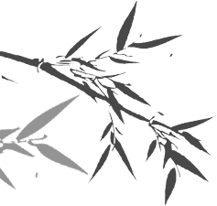

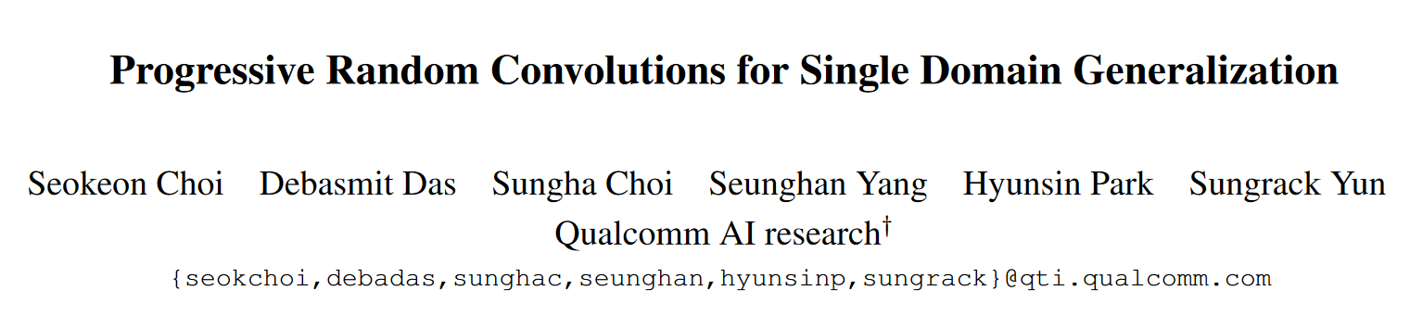
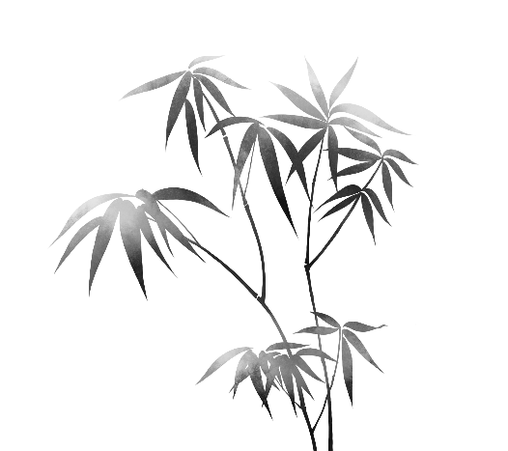
郭毅 CVPR 2023

Slide 2
1
Introduction
2
Methodology
3
Experiment
4
Conclusion

Slide 3
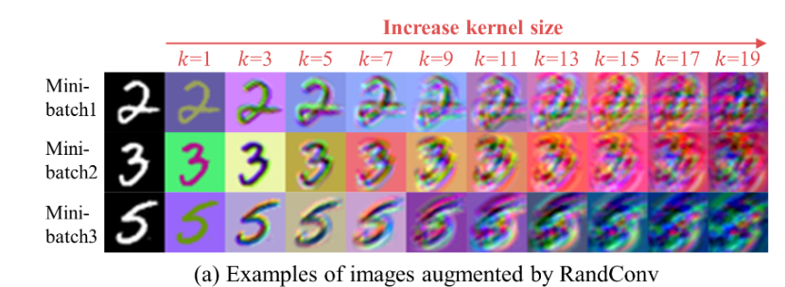
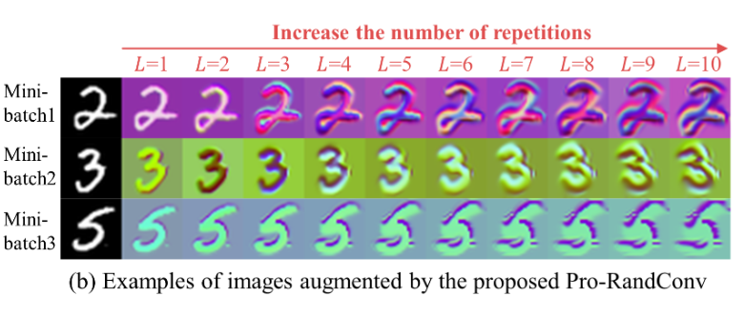
Introduction
Motivation:
RandConv is a simple and lightweight image augmentation technique, but this method has structural limitations. Firstly, the images augmented by RandConv easily lose its semantics while increasing the kernel size.
Secondly, RandConv lacks the inherent diversity of a single convolution operation

Slide 4
Introduction
Contributions:
• propose a progressive approach of recursively stacking small-scale random convolutions to improve the style diversity while preserving object semantics.
• develop a random convolution layer with deformable offsets and affine transformation to promote texture and contrast diversity for augmented images.
• achieves the state of the art on domain generalization benchmarks without using any images.

Slide 5
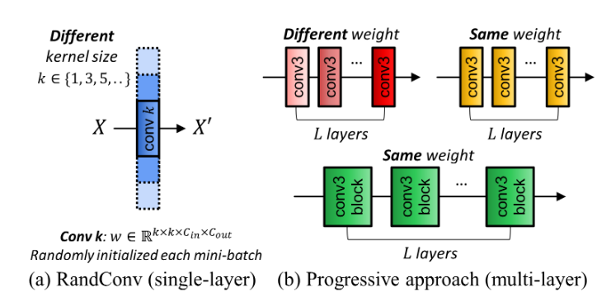
Methodology
Difference:
1. multi-layer structure
alleviate the semantic distortion issues by reducing the impact on pixels
2. Stack random convolution layers of the same weights in order to generate mode effective virtual domains rather than using different weights. Can be interpreted as gradually increasing the distortion magnitude of a single transformation to the central pixels.
[1] Wenjie Luo, Yujia Li, Raquel Urtasun, and Richard Zemel. Understanding the effective receptive field in deep convolutional neural networks. Advances in neural information processing systems, 29, 2016. 2, 4, 7

Slide 6
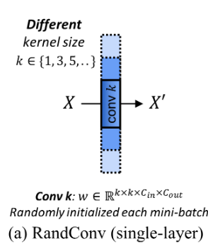
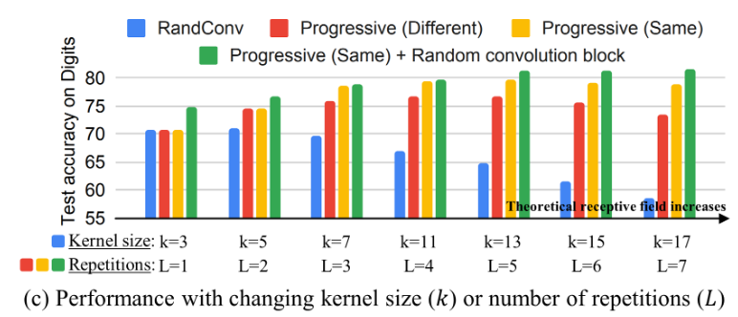
Methodology
a large-sized kernel can become an ineffective data augmentation type that interferes with learning generalizable visual representations due to excessively increased randomness and semantic distortions.
RandConv tends to modify the texture of the input image while keeping the shape of object intact

Slide 7
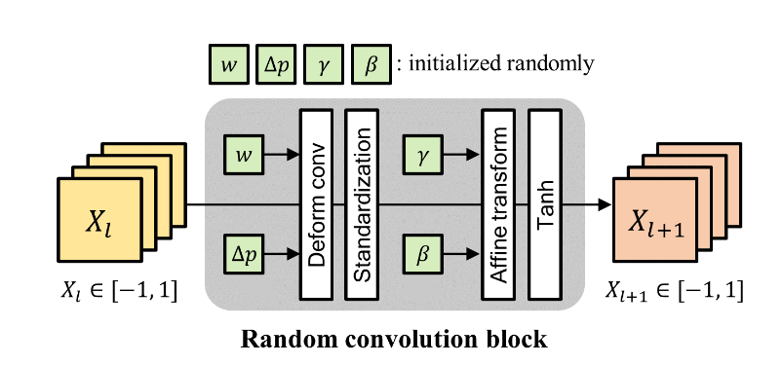
Methodology
a single convolution layer is replaced with a random convolution block designed for supporting texture and contrast diversification.
Notes:
Deformable conv 可变卷积
Standardization 标准化
Affine transform 仿射变换
Tanh 双曲正切函数
e develop the random convolution operation by relaxing the constraints on the fixed grid, which can further increase the diversity of texture modifications.
通过放松对固定网格的约束，发展随机卷积运算，可以进一步增加纹理修改的多样性。

Slide 8
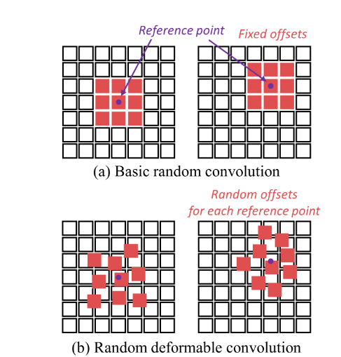
Methodology
Texture diversification
a single convolution layer is replaced with a random convolution block designed for supporting texture and contrast diversification.
weights are the same for each reference point, but offsets are assigned differently
Notes:
Deformable conv 可变卷积
Standardization 标准化
Affine transform 仿射变换
Tanh 双曲正切函数
e develop the random convolution operation by relaxing the constraints on the fixed grid, which can further increase the diversity of texture modifications.
通过放松对固定网格的约束，发展随机卷积运算，可以进一步增加纹理修改的多样性。

Slide 9
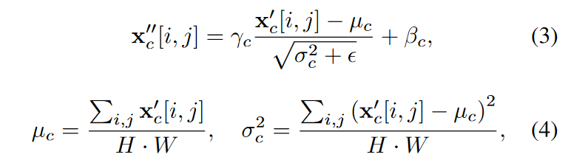
Methodology
Contrast diversification
Assume : input pixel values follow the standard normal distribution, the output passed through a random convention layer should follow the same distribution.
However, input may not have an ideal distribution,
the output distribution can not cover global style.
Contrast diversification: intentionally change the distribution of output randomly
a single convolution layer is replaced with a random convolution block designed for supporting texture and contrast diversification.
Notes:
Deformable conv 可变卷积
Standardization 标准化
Affine transform 仿射变换 进行contrast diversification
Tanh 双曲正切函数
e develop the random convolution operation by relaxing the constraints on the fixed grid, which can further increase the diversity of texture modifications.
通过放松对固定网格的约束，发展随机卷积运算，可以进一步增加纹理修改的多样性。

Slide 10
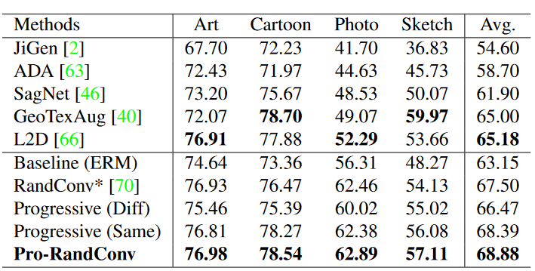
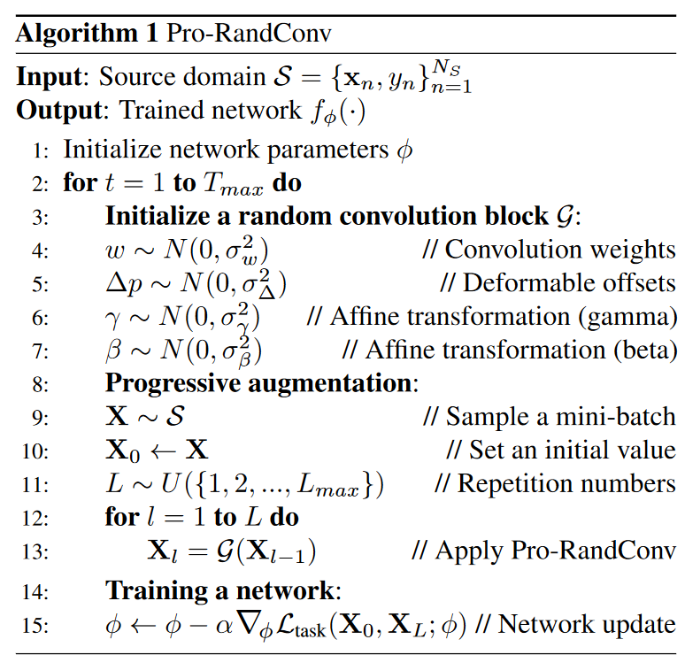
Experiment

Slide 11
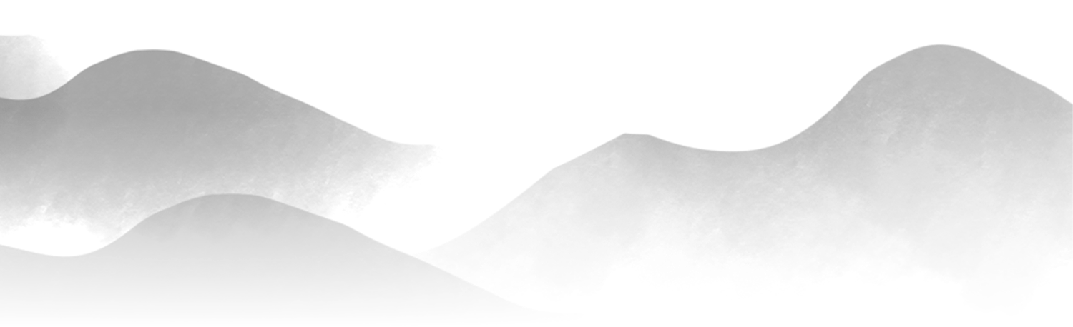
THANKS !!!
感谢您的观看
汇报人：郭毅
Notes:
51PPT模板网 www.51pptmoban.com

